Slide 2
EINDHOVEN STRIKES ON APRIL 23!
With 25,000 people we protested at Malieveld, yet the government continues to demolish higher education. We cannot accept this.
That's why educational institutions across the country are striking as part of a relay strike. On April 23th, it's our turn.
Colleagues in Leiden (March 10), Utrecht (March 11), Nijmegen (March 13), Amsterdam (March 17), Groningen (March 18), Twente (March 25), VU Amsterdam (April 7), Rotterdam ( April 8) Tilburg (April 10), Wageningen (April 14), Maastricht (April 16) and Delft (April 24) are striking.

Slide 3
WHAT CAN YOU DO?
Talk with employees about why it is important that they participate in the strike and show solidarity.
Come show your support during our strike on April 23th. It means a lot when you are there. Together we can fight these cuts!
Join the union FNV or AOb!
Help us with distributing flyers, action material can be found online: FNV.nl/TU-Eindhoven

Slide 4
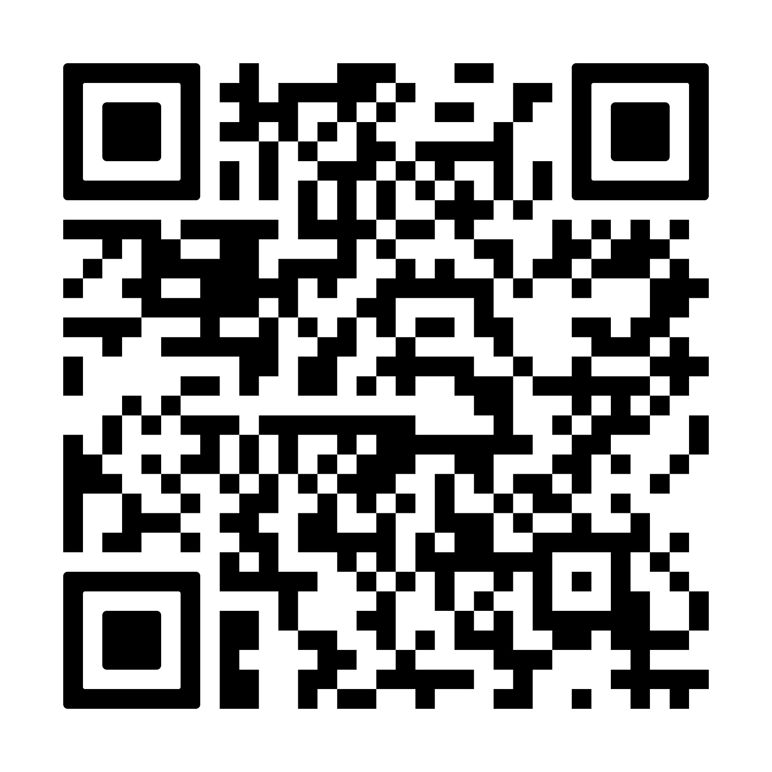
Visit fnv.nl/ho for more info
Visit aob.nl for more info

