Slide 1





Slide 2
WUR STRIKES ON APRIL 14!
With 25,000 people we protested at Malieveld, yet the government continues to demolish higher education. We cannot accept this.
That's why educational institutions across the country are striking as part of a relay strike. On April 14th, it's our turn.
Colleagues in Leiden (March 10), Utrecht (March 11), Nijmegen (March 13), Amsterdam (March 17) and Groningen (March 18) went on strike before us. More universities will follow.

Slide 3
WHAT CAN YOU DO?
Talk with people who are working at WUR (teachers, support staff, etc.) about why it is important that they participate in the strike.
Come show your support during our strike on April 14th. It means a lot when you are there. Together we can fight these cuts!
Join the union FNV or AOb!
Help us with distributing flyers, action material can be found online: fnv.nl/wageningen-universiteit

Slide 4

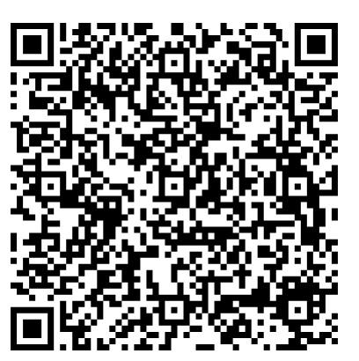
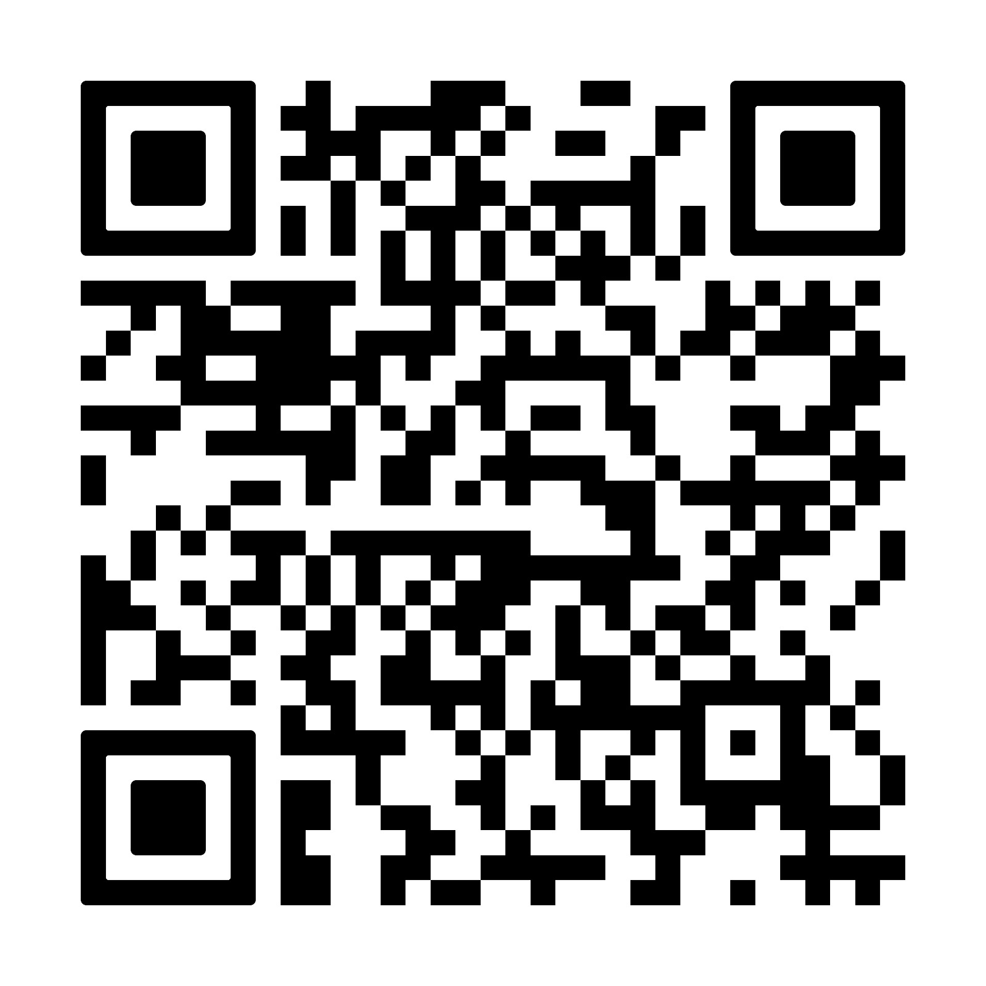


Visit fnv.nl/ho for more info
Visit aob.nl for more info

